Slide 1
Data
Outcome
ICFES – NATIONAL MINISTRY OF EDUCATION 2011-2023
Transition rate to higher education: proportion of secondary graduates in each municipality who enroll in a HE (technical, technological, or university) the following year.
Annual, municipal level, based on individual data.
Treatment
NATIONAL CENTER OF HISTORICAL MEMORY – CNMH 2011 - 2023
FARC-related violent events per municipality.
Selective murders, massacres, attacks on settlements, terrorist acts, sexual violence, kidnappings, antipersonnel mines, forced displacement, property damage, war actions.
Controls
ADMINISTRATIVE DATA – NATIONAL DEPARTMENT OFFICE
Tax income, national transfers, public expenditure, and hectares under coca cultivation.

Slide 2
Treatment definition
Total municipalities 1121
How to identify municipalities with FARC exposure?
Total events = Selective murders, Massacres, Attacks on settlements, Terrorist acts, Sexual violence, Kidnappings, Antipersonnel mines, Forced displacement, Damage to property, War actions
Ceasefire Dec 2014
Peace agreement Nov 2016
c
Robustness check
Year | Total events | Total FARC related events | Total NoFarc events | Total unidentified events
2011 | 4444 | 1329 | 3115 | 2638
2012 | 5513 | 2362 | 3151 | 2636
2013 | 4367 | 2165 | 2202 | 1684
2014 | 2665 | 631 | 2034 | 1613
Total | 16989 | 6487 | 10502 | 8571
 |  | 38.18% | 61.82% | 50.45%
Concern with unidentified events
391 mun with at least 1 FARC event
517 mun with no FARC events, but with at least 1unidentified event.

Slide 3
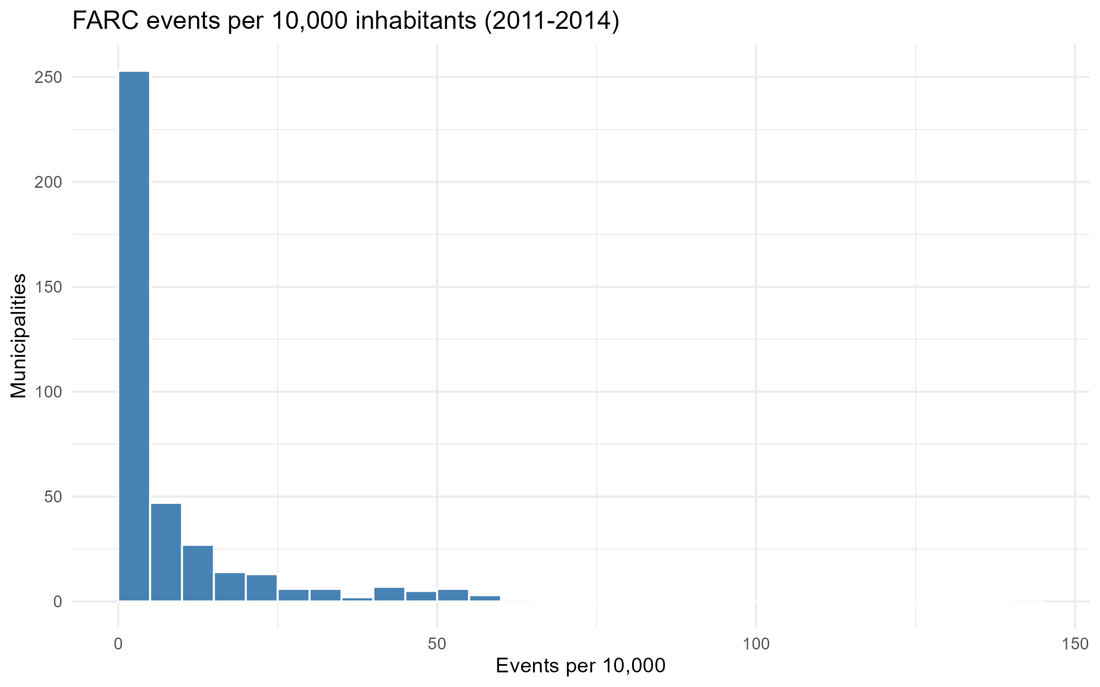
Treatment Specification
Binary presence: exposed vs. unexposed municipalities
Treatment = 1 if farc_events > 0 . 0 otherwise
Treated municipalities: 391 (34.9%)
Control municipalities: 730
2. Intensity high/low/no exposure conditional on >=1 attack (Heterogeneous effect)
Pure control (unexposed): 730 municipalities
Low exposure: 196 municipalities (<= median for positive events)
High exposure: 195 municipalities (> median for positive events)
3. High exposure vs. unexposed and low exposure.
Check sensitivity to different cutoffs.
Treatment

Slide 4
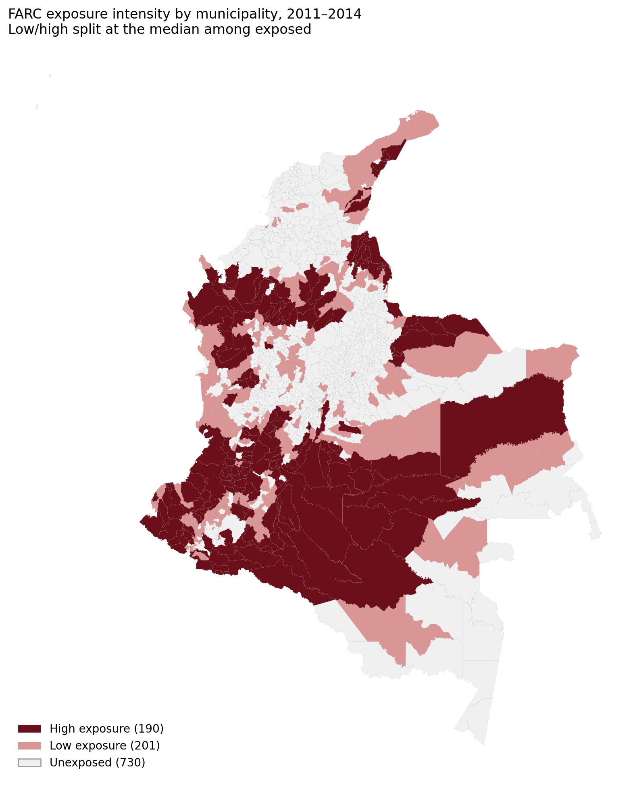
Geographic distribution of treatment
Spillovers are a concern:
Outcomes in control municipalities may depend on treatment in neighboring municipalities.
Possible lower bound: If spillovers are positive, control units become partially treated. The estimated effects are too small.
What can I do?
Exclude controls near treated municipalities and compare treated vs “clean” controls.
Robustness check

Slide 5
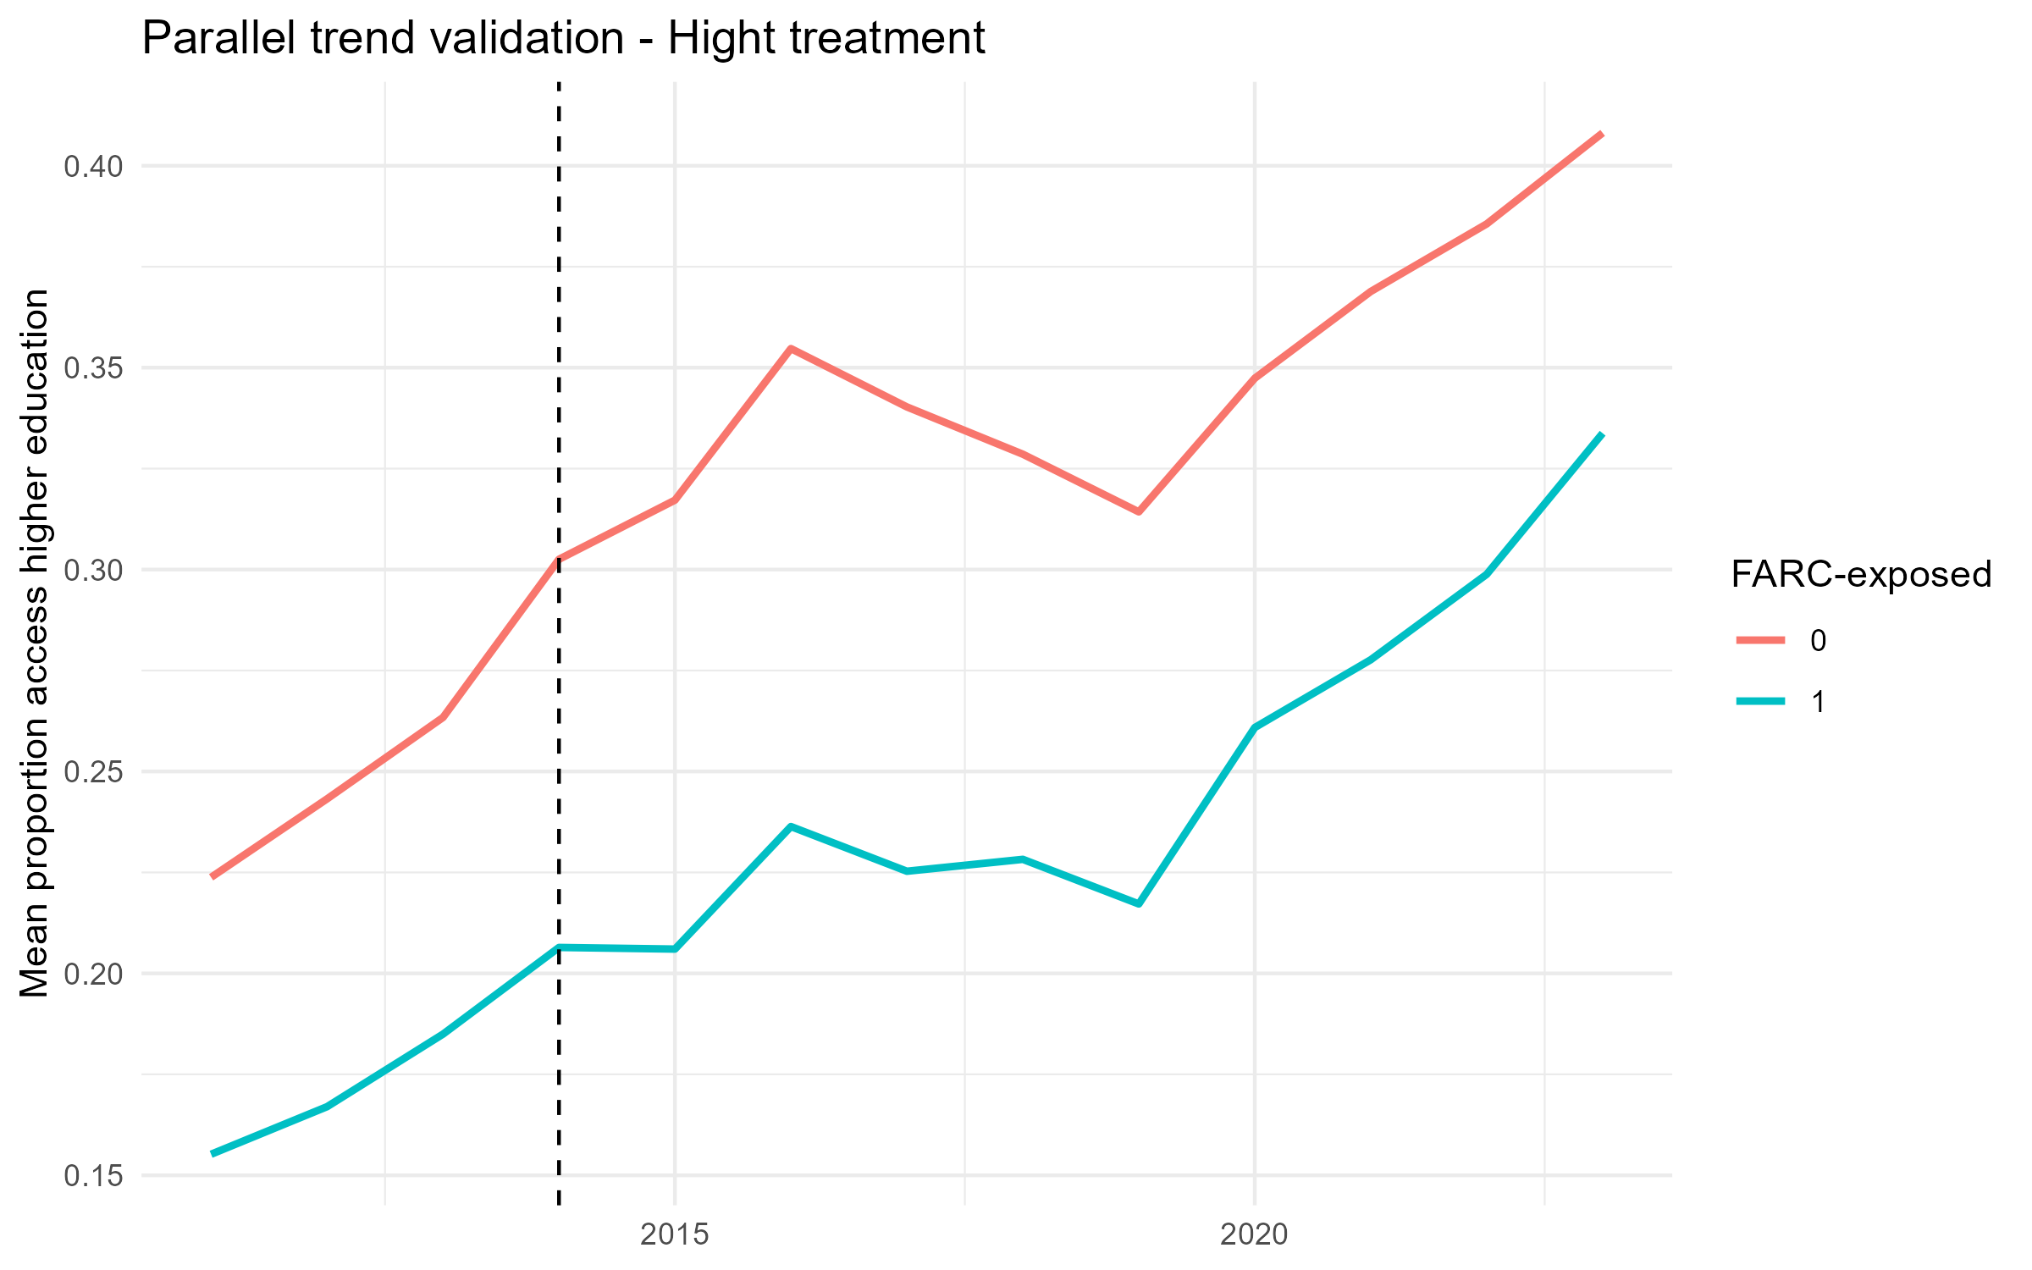
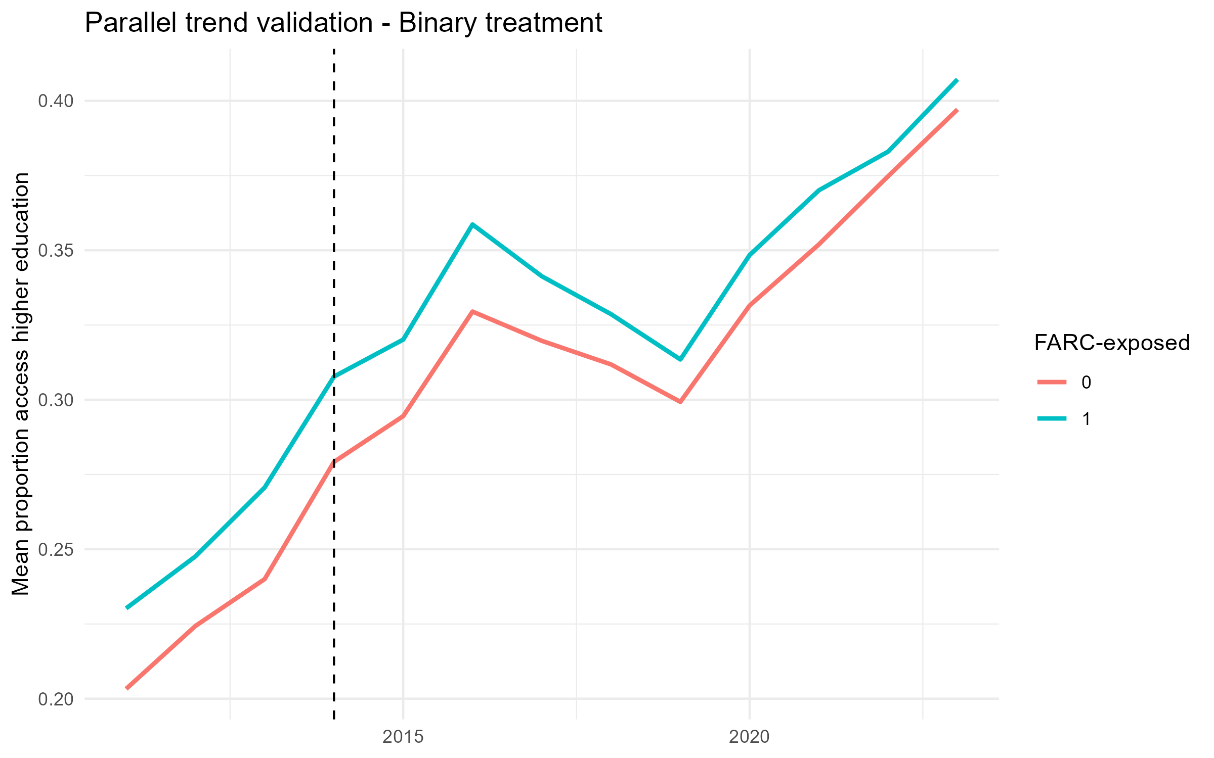
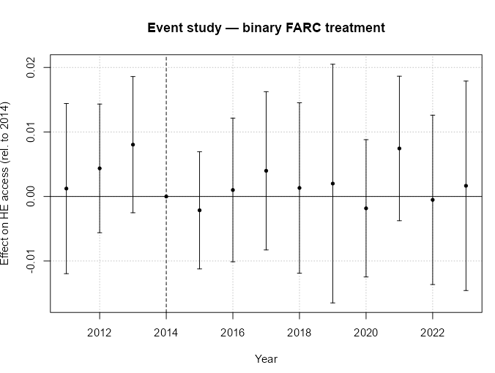
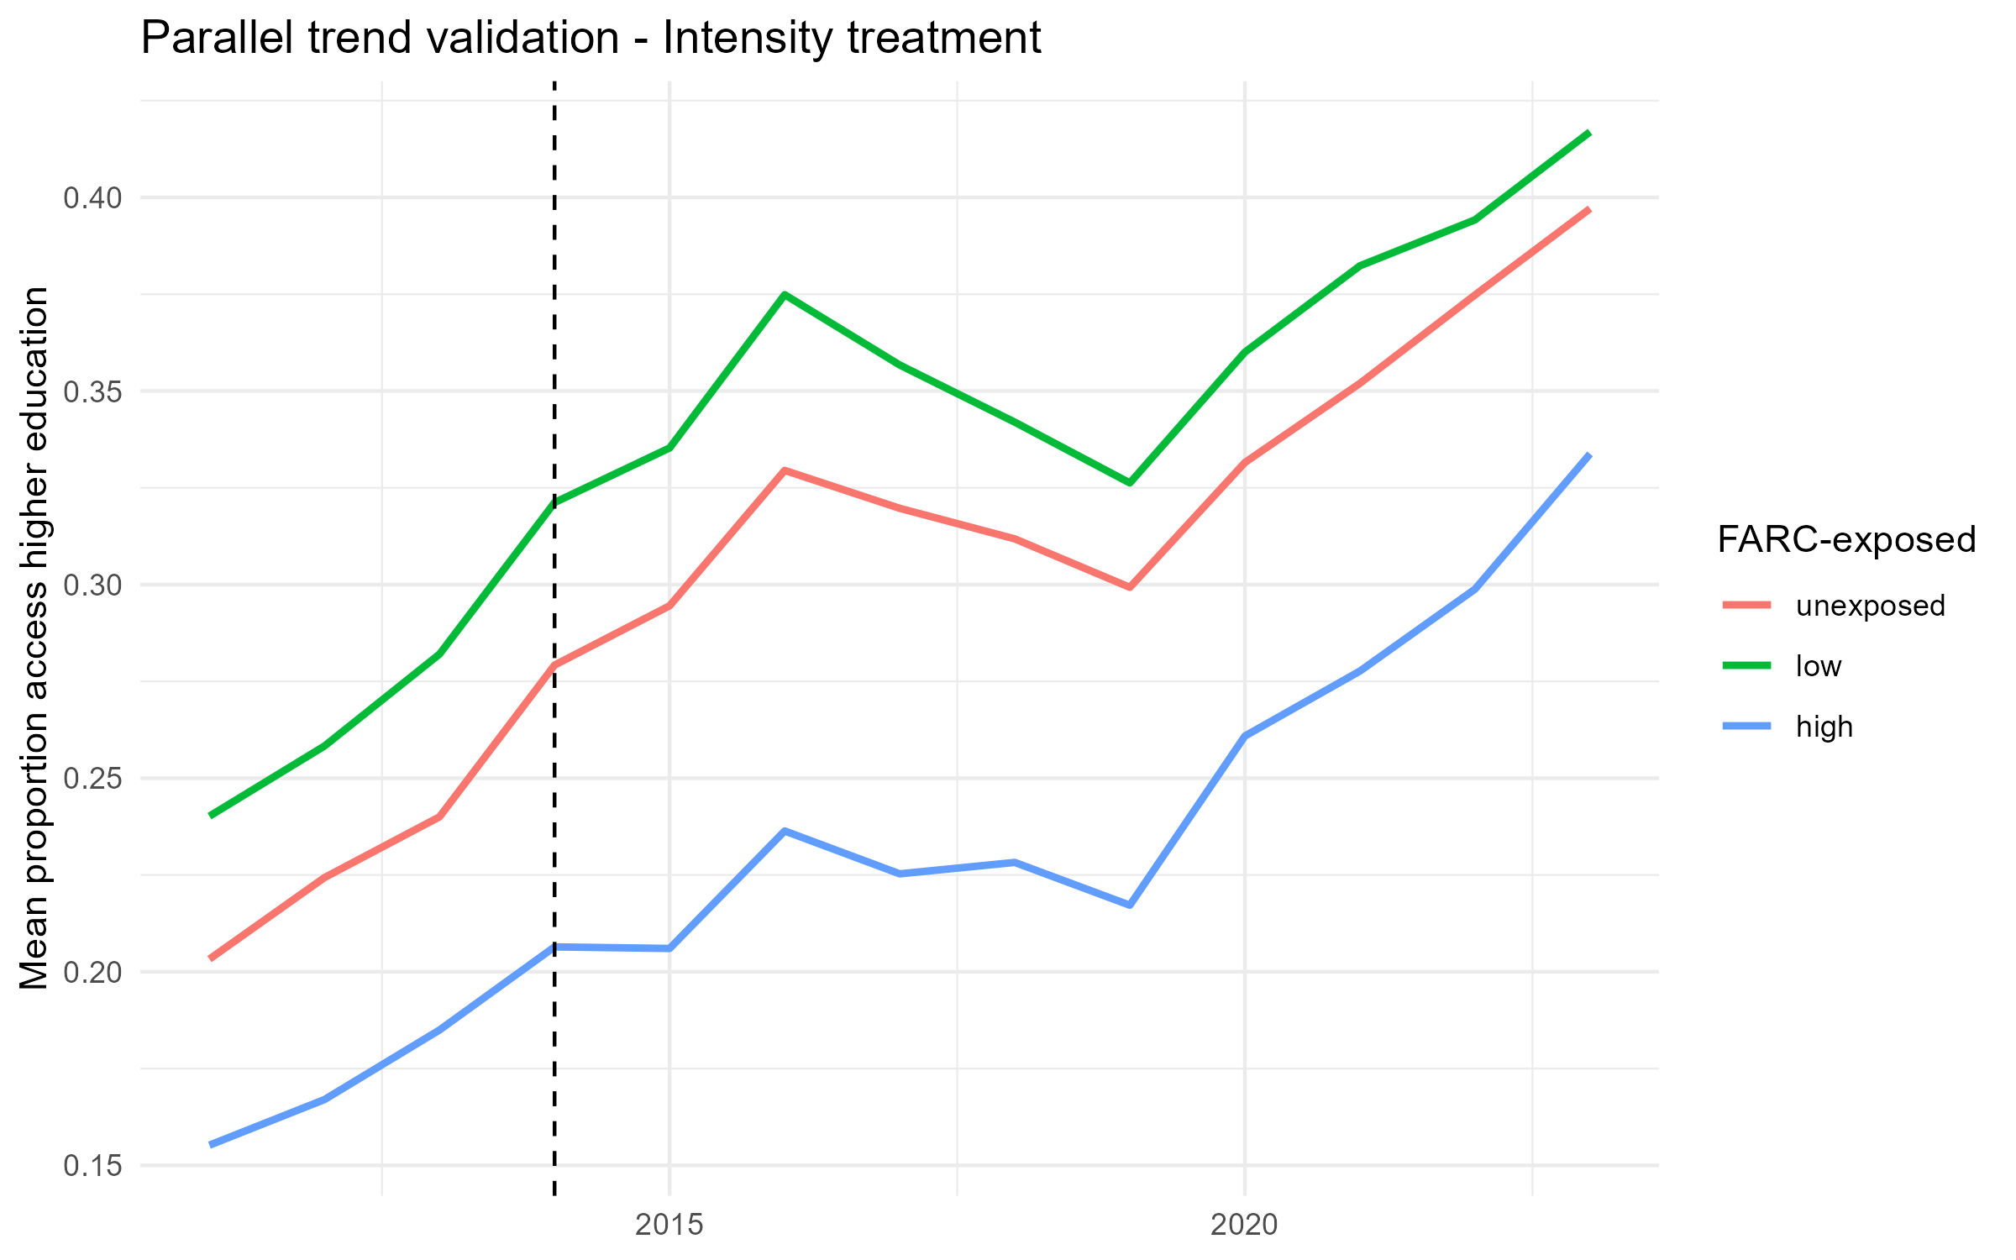
Parallel trend

Slide 6
Next steps
Event study using an alternative treatment definition
Estimate the baseline Difference-in-Differences (DiD) specification without controls.
Estimate the DiD specification including municipal-level controls.
Analyze heterogeneous effects by FARC exposure intensity.
Analyze heterogeneous effects by sex.

